Slide 1

CAPSTONE
EDA Laptop specifications and price
AMRAOUI Taher - MIMI

Slide 2
From where we did get this data?
Scrapped this data from flipkart.com
used an automated chrome web extension tool called Instant Data Scrapper
What we will do?
Visualize this data, and prepare high-quality charts as much as we can.
To help us to take a global view at laptops and their specifications and prices,
And maybe even more, help us to build a ML model
Notes:
highly recommended to use this beautiful tool to get the data from anywhere on the web. it's very easy to use, no coding knowledge is required

Slide 3
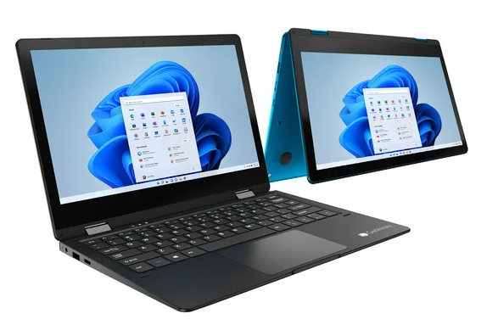
Laptop is a broader term, it applies to both laptops and notebooks, smartbooks.
Notebooks usually include laptops, made in a folding form factor. The laptop is carried folded, this allows you to protect the screen, keyboard and touchpad during transportation. This is also due to the ease of transportation (most often, a laptop is transported in a briefcase, which allows you not to hold it in your hands, but hang it on your shoulder).
The world's main laptop manufacturers are Acer, Asus, MSI, Huawei, LG, DELL, Lenovo, HP.

Slide 4
IMPORTING LIBRARIES AND LOADING DATA

Slide 5
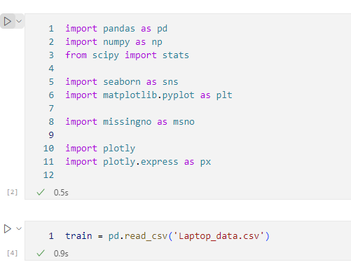
Notes:
Libraries for data visualtion ; Comma Separated Values and convert it into a Pandas DataFrame.

Slide 6
DATA INFORMATION

Slide 7
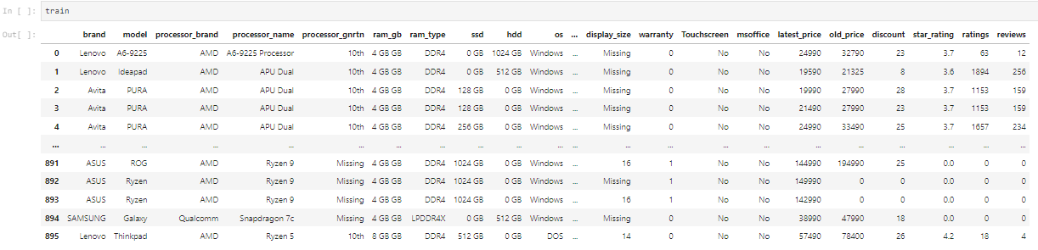
Let's look at the data.
The data are presented by 896 objects according to 23 features.

Slide 8
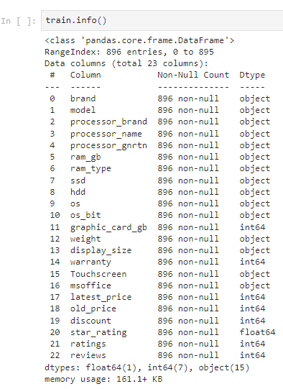
It is necessary to find out the number of categorical and numerical features

Slide 9
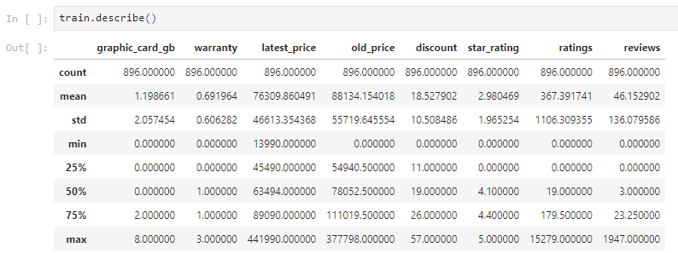
Let's look at the statistics of the dataset
Hypothesis: There are outliers both for the minimum price values and for the maximum ones. There are also outliers in ratings and reviews, which can indicates of fake reviews to boost sales.
Notes:
as well as the presence of possible outliers.

Slide 10
EXPLORATORY DATA ANALYSIS
Notes:
EDA is to gain a better understanding of the data and identify potential issues or areas for further investigation.

Slide 11
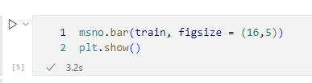
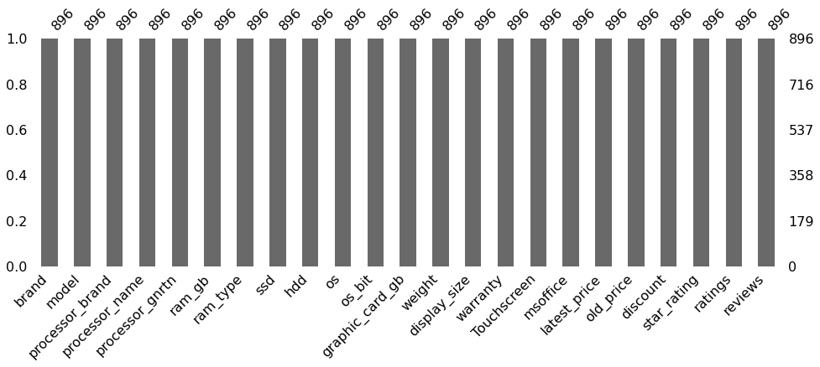
Let's check the information for gaps.
There are no gaps in the data. But they can be disguised as column values.
Notes:
identifying missing values, visualizing missing data patterns, and imputing (filling in) missing values.
None
np.nan (NumPy's representation of a missing value)
NaN (Pandas' representation of a missing value)
'' (empty string)
[] (empty list)
{} (empty dictionary)

Slide 12
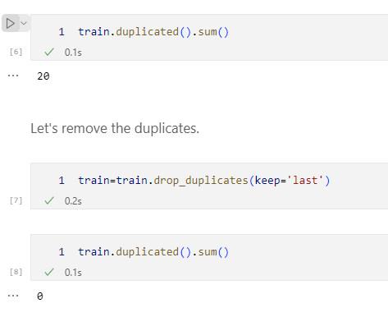
Check the dataset for duplicates.
Notes:
the keep parameter is set to 'last', which means that when multiple duplicate rows are found, only the last duplicate row will be kept and the rest will be removed.

Slide 13
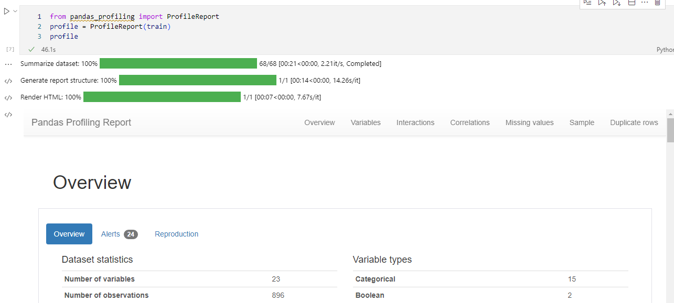
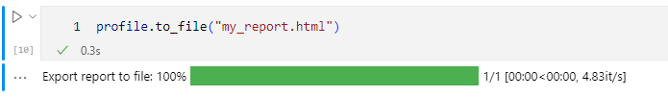
Notes:
number of rows and columns in the DataFrame, the data types of each column, the number of missing values,barplot, Duplicate rows(show), Distinct, Total size in memory, Interactions, Correlations heatmap/table, summary statistics, and various visualizations of the data.

Slide 14
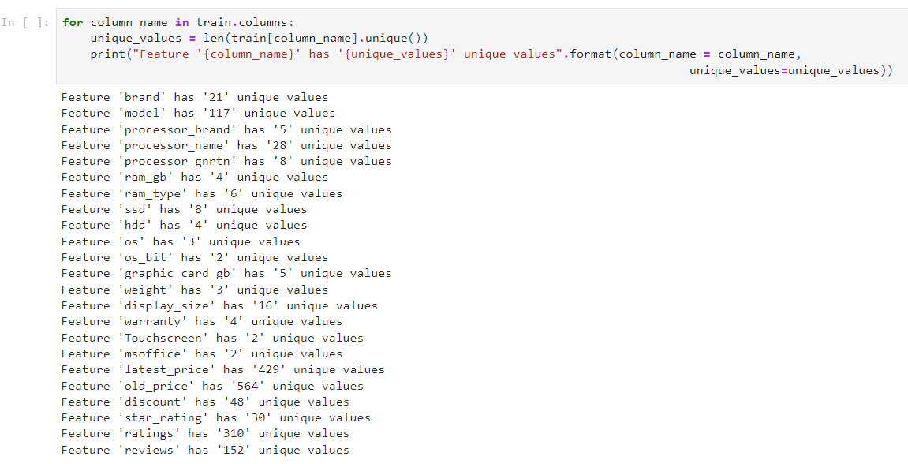
Let's separate the continuous variables from the categorical ones and do the analysis.
Continuous variables are 'latest_price', 'old_price', 'ratings', 'reviews’.
Categorical all others except 'model'.

Slide 15
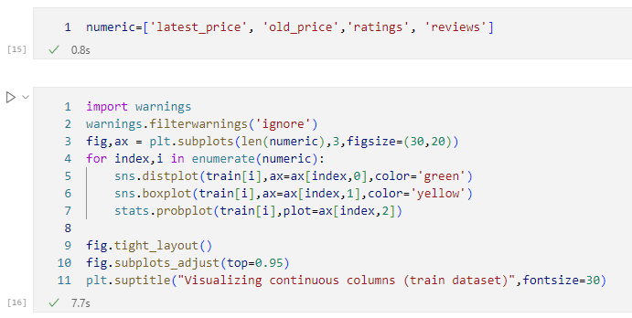
Let us analyze continuous variables.

Slide 16
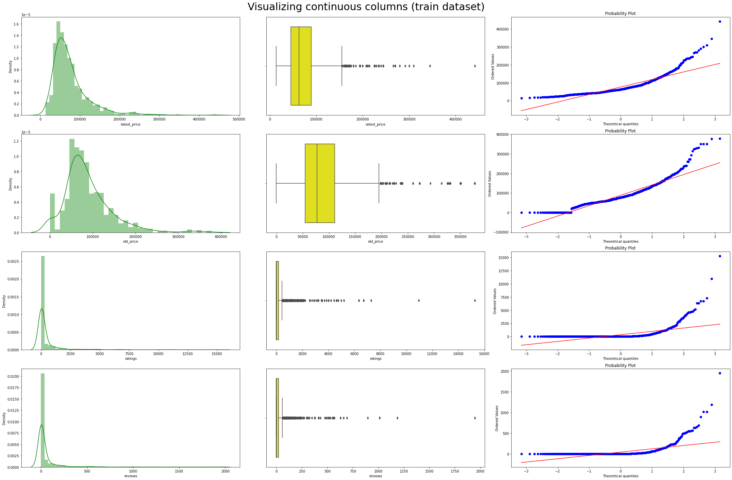
Notes:
Distplot creates a histogram and fits a KDE kernel density estimation smoothed version of the histogram
Give a sense of the shape of the distribution symmetrical/skewed
Boxplot - box-and-whisker
Determine how tightly data is grouped
Tell you the values of your outliers
Probplot
is used to create a probability plot for a given set of data. A probability plot is a graphical method for easily visualize the distribution of your data and assessing whether a set of data is approximately normally distributed.

Slide 17
Let's carry out a mini-analysis of the presented graphs:
Laptop price variables are quantitative and have a relatively normal distribution with slight skews. To predict these variables, you can either use them or take the logarithm of the variable to get the best normal distribution.
When forecasting target variables in the ratings, reviews variables, there are very strong outliers that will need to be removed. Deleting all data outliers is ideal, but you need to remember the unspoken rule that you need to delete no more than 1% of the dataset, otherwise there is a chance of losing important information. Also, when removing outliers, it is worth remembering that there is a premium segment of laptops that can be erroneously classified as outliers. Since the ratings, reviews variables will probably correlate with the target variables, it is not worth deleting outliers.

Slide 18
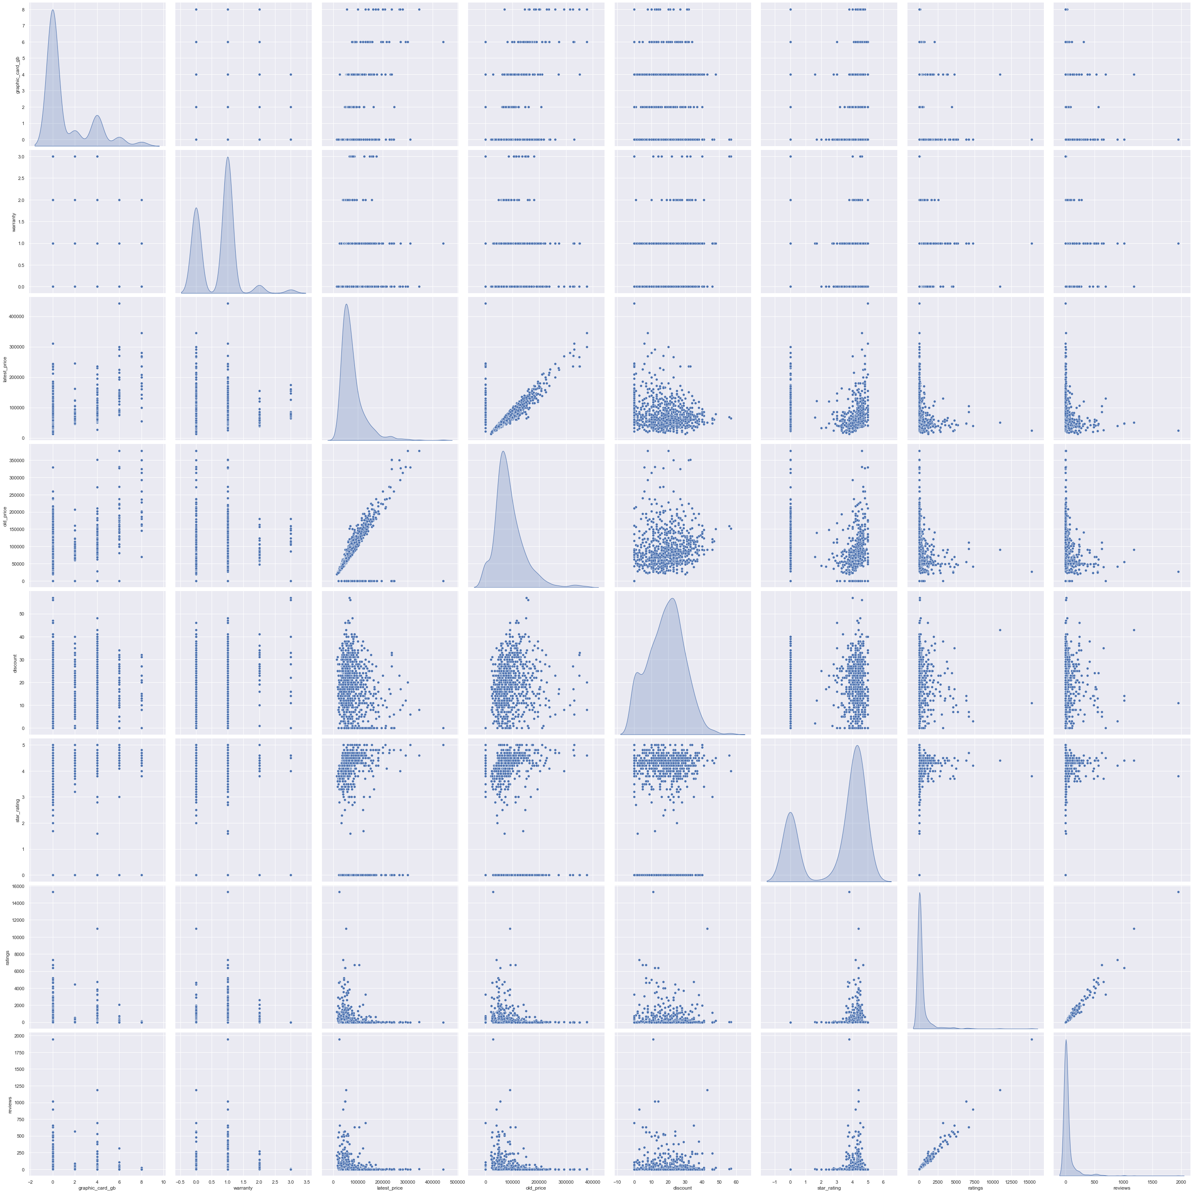
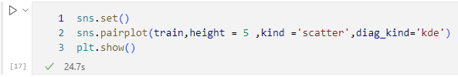
On the graphs presented, it is easy to see the linear correlation of the ratings and reviews variables. There is also a correlation between latest_price and old_price.

Slide 19
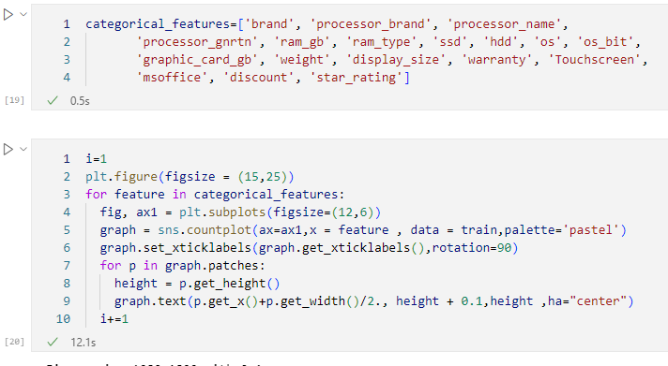
Let's analyze categorical variables.
Notes:
sns.countplot() is a function in the seaborn library (sns) that is used to create a bar plot that shows the count of occurrences for each category in a categorical variable. It is useful for visualizing the distribution of a categorical variable.

Slide 20
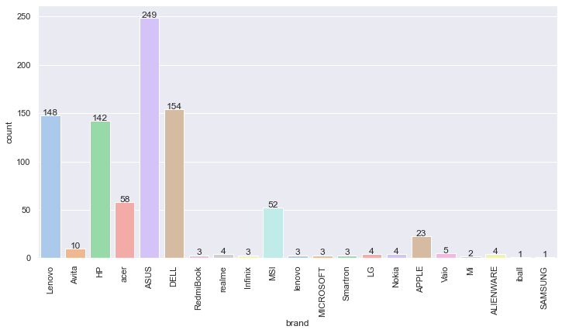
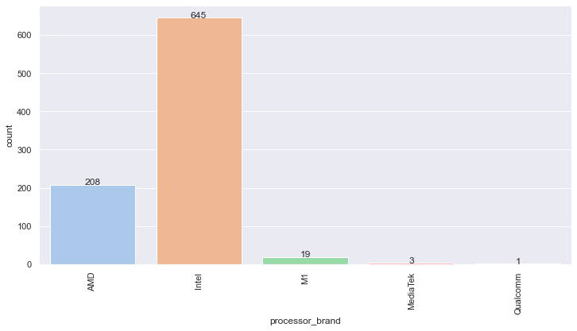
• The largest number of laptops are produced under the brands ASUS, DELL, HP, and Lenovo.

Slide 21
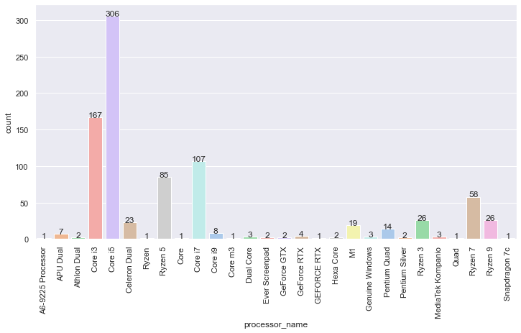
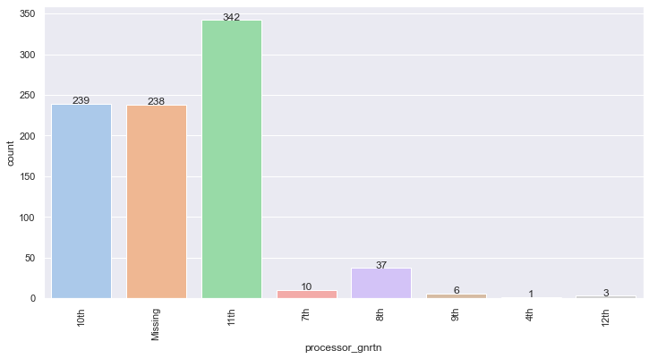
• The most common processors are Intel processors, especially Core i5, Core i7, and Core i3. This phenomenon can be explained by low price and high performance.

Slide 22
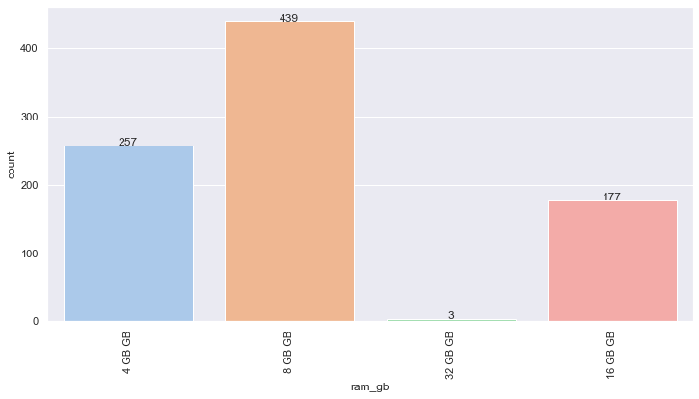
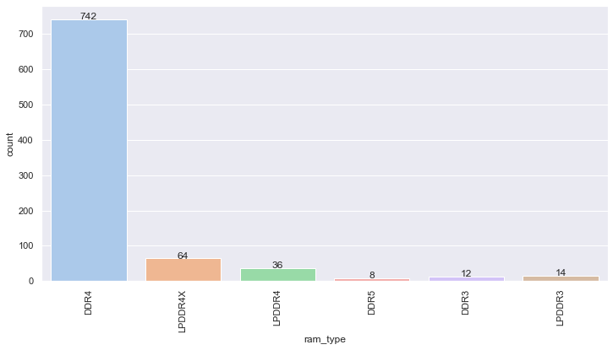
• In the ram_gb variable, the value of 8 Gb is the mode. This means that this amount of memory is enough for most tasks.
Demand creates supply:)

Slide 23
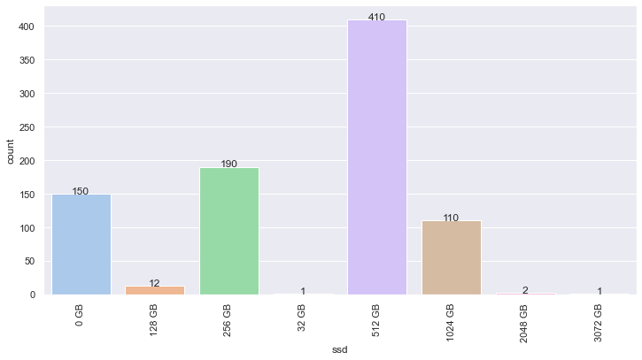
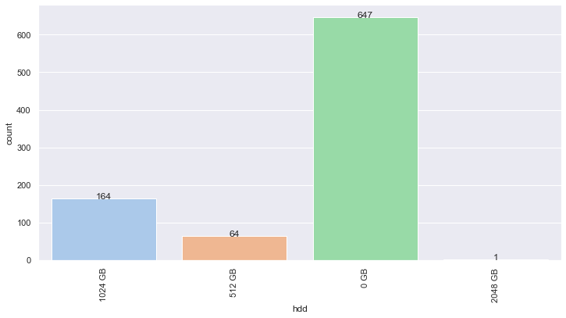
• Most laptops are sold with an SSD drive. Many manufacturers, in an effort to win in the competition, save on additional slots in laptops by installing only one storage device. Choosing such a model, for example, with a fast SSD, you risk being left without a system and without personal data.
The option with one HDD is also not very preferable, because. This type of media today demonstrates very low data exchange rates. Your system will be slow to boot, and applications will be annoying with the slowness of launching and processing data. Therefore, when choosing a device, give preference to the SSD + HDD dual disk system.

Slide 24
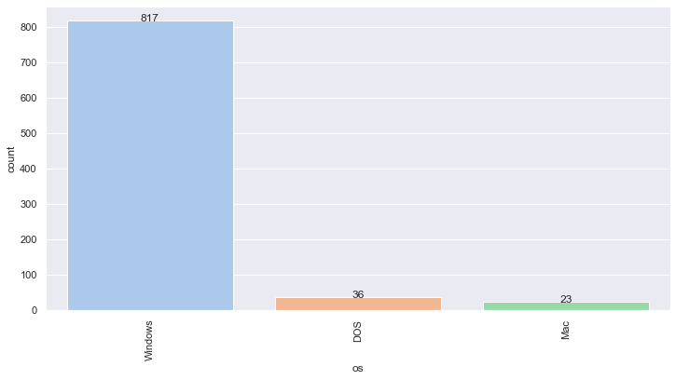
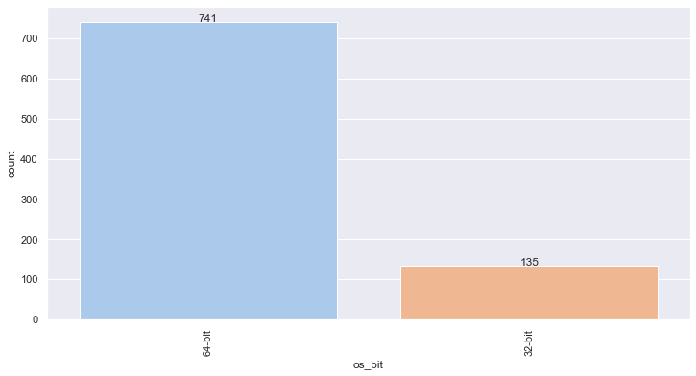
• The most common operating system value is Windows 64-bit. This can be explained by the simplicity and cheapness of using this system, as well as a much more extended distribution of programs.
Notes:
Compatibility
far ahead

Slide 25
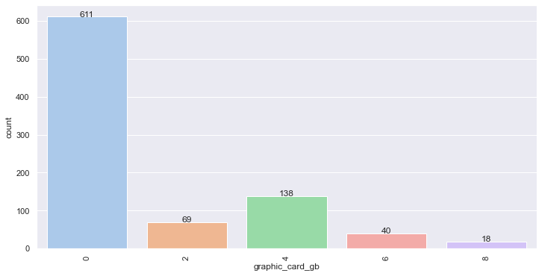
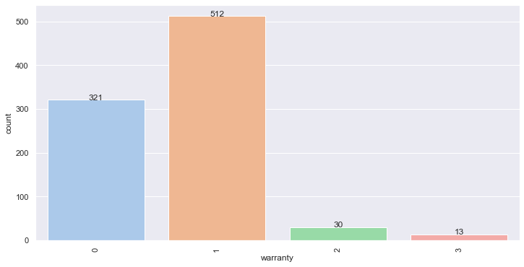
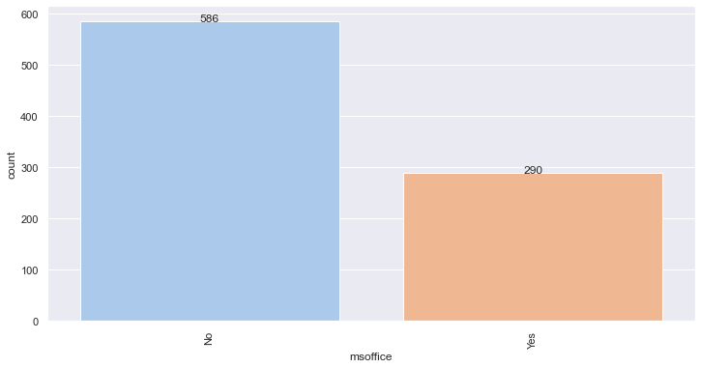
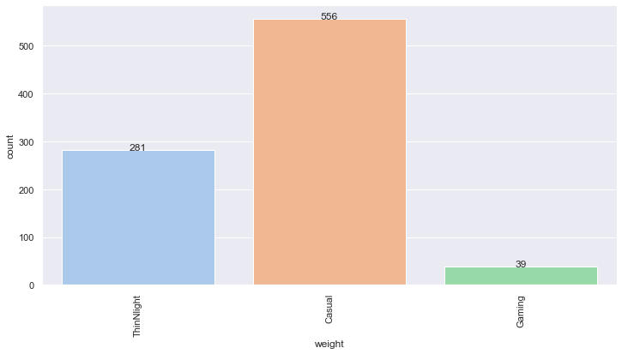

Slide 26
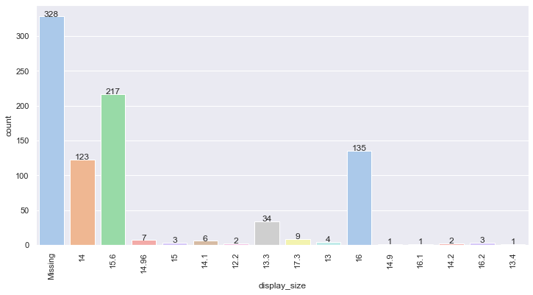
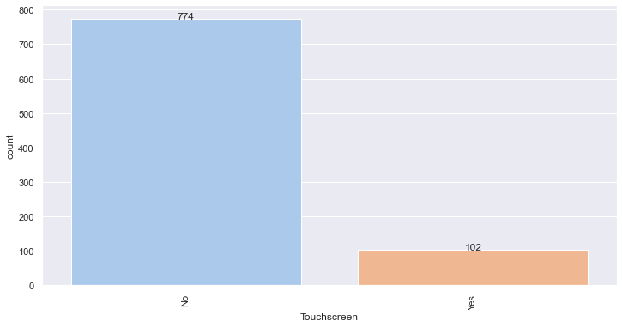
• The mode of the display_size variable is 15.6, indicating high buyer demand. This is due to the fact that these laptops are used both at work and at home.

Slide 27
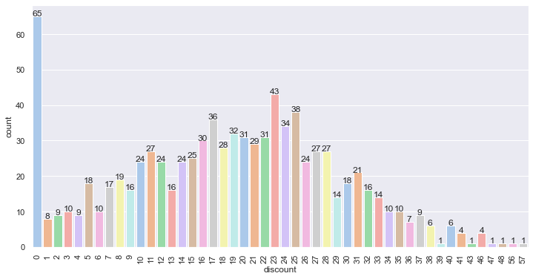
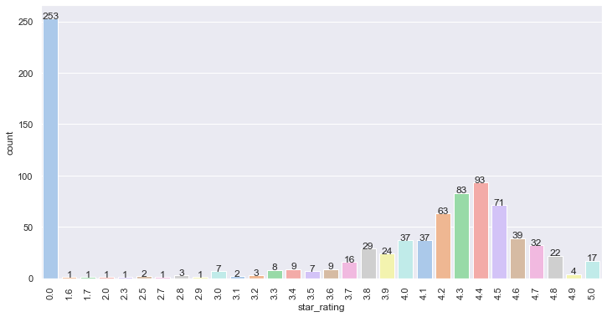

Slide 28

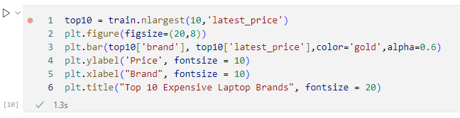
Let's analyze the 10 cheapest and 10 most expensive laptops, depending on the brand.

Slide 29
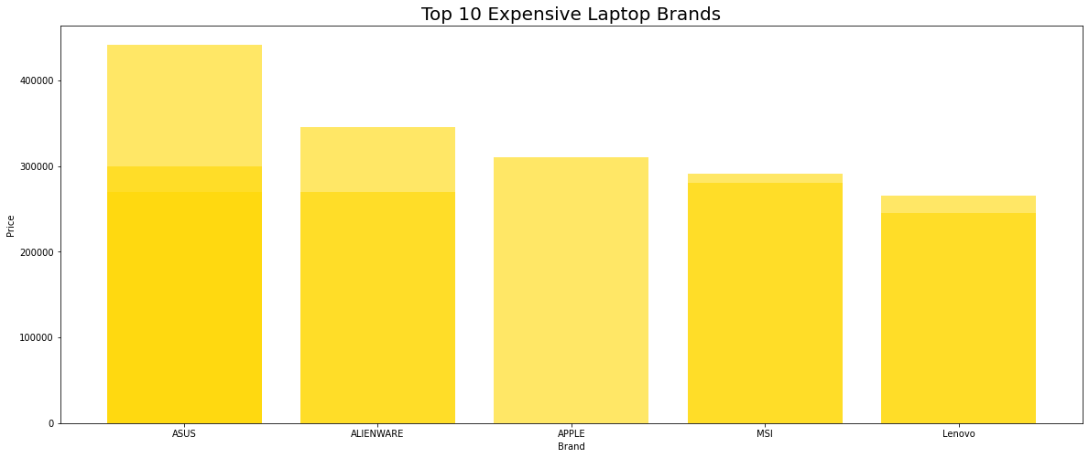

Slide 30
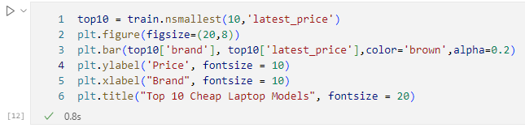
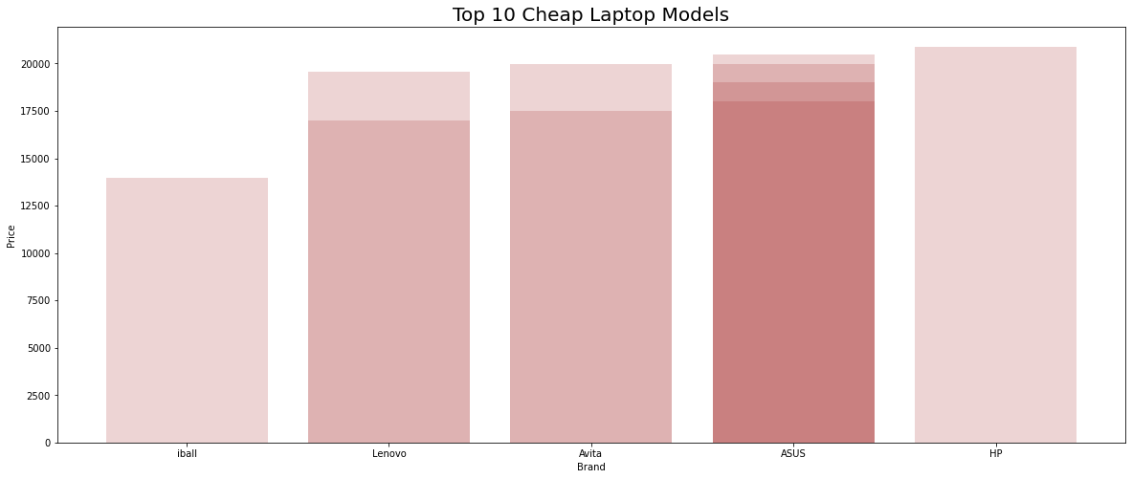

Slide 31
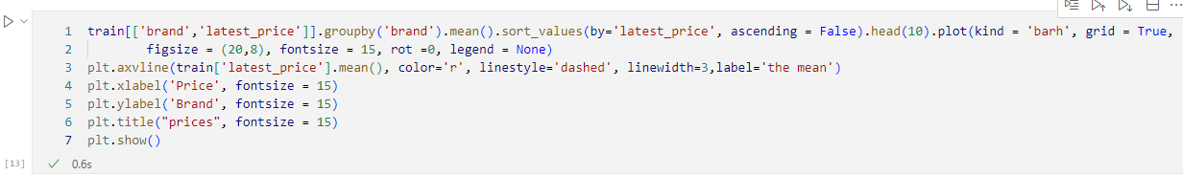
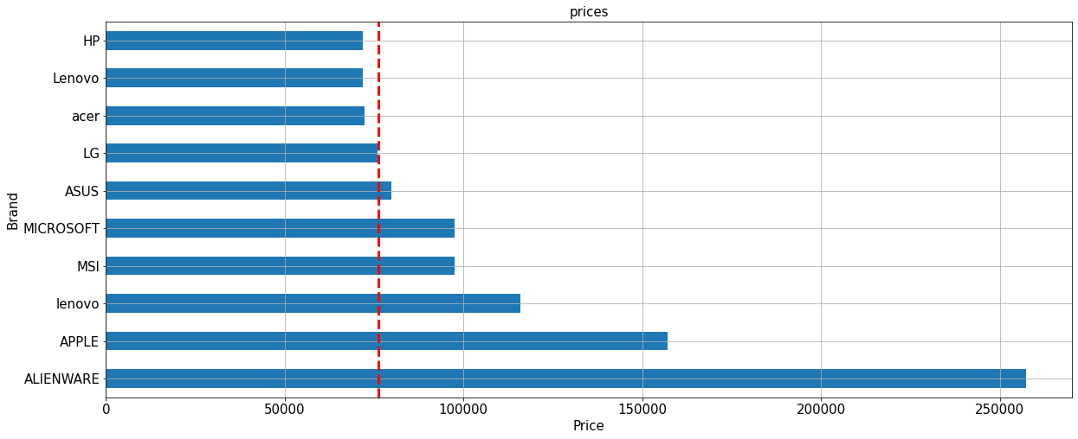

Slide 32
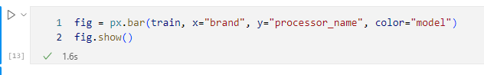
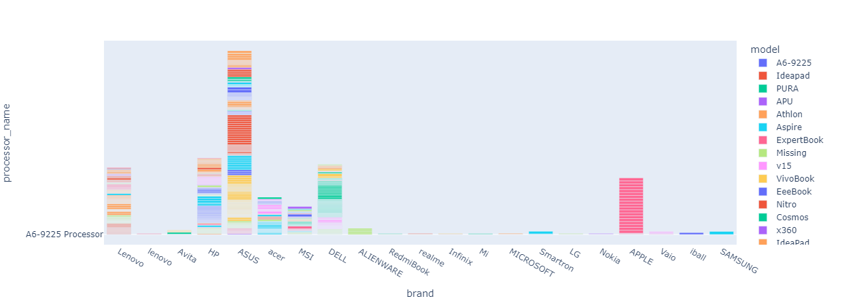
• Acer, HP, ASUS, Lenovo, Dell, MSI, which have many models, have lots type of Processor
• Few-Model laptop are also have fewer type of Processor.
• Most brands have only one model, and have their own processor

Slide 33
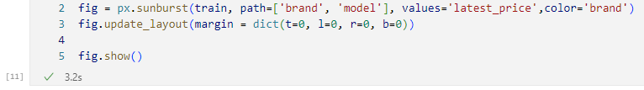
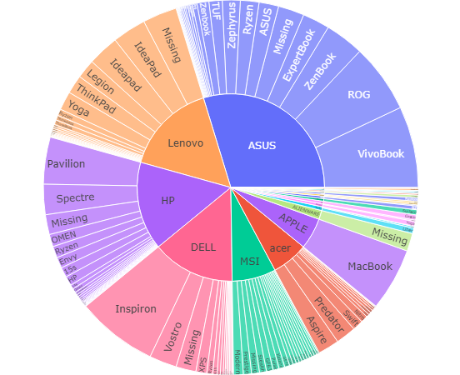
Let's look at the most expensive laptops using a pie chart.
• Some brand has only one model, like SAMSUNG, APPLE, Microsoft
• HP, ASUS, Lenovo, DELL, acer have the most type of model

Slide 34
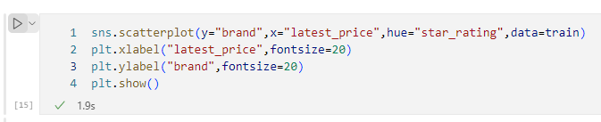
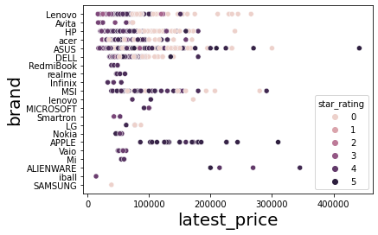
• More expensive of the ASUS products, and customers are more satisfied. It can assume that ASUS offer both high and low quality models.
• There are no relationship in price and star ratings in MSI, but its products have high and concentrated satisfaction. Maybe MSI offer only high quality model
• APPLE has the highest satisfaction in fewer model's brand, and its price also the highest. It can assume that Apple's customers are loyalty to their products, increasing the value of the brand.
• Few-model brand star rating are above 3.5, which is higher than many-model brand.

Slide 35
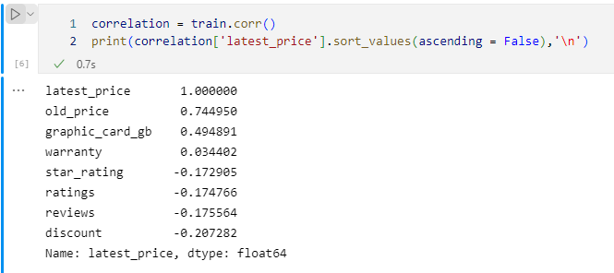
To compare continuous variables, we use the correlation matrix. It will also include some categorical variables.

Slide 36
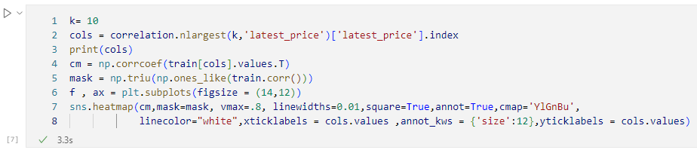
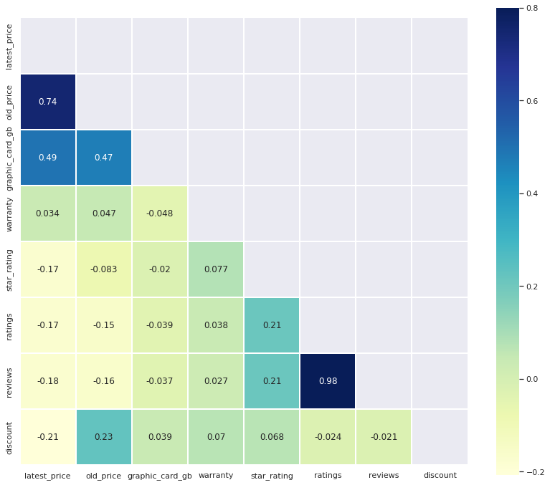
Conclusions from the construction of the correlation matrix:
the old and new prices correlate, this is not surprising :) In the future, to predict the price of a laptop, it is proposed to delete the value of the old price
price is largely dependent on the memory capacity of the graphics card.
rating and reviews are very strongly correlated and are duplicate information, it is proposed to remove the reviews.

Slide 37
CONCLUSIONS AND RECOMENDATIONS

Slide 38
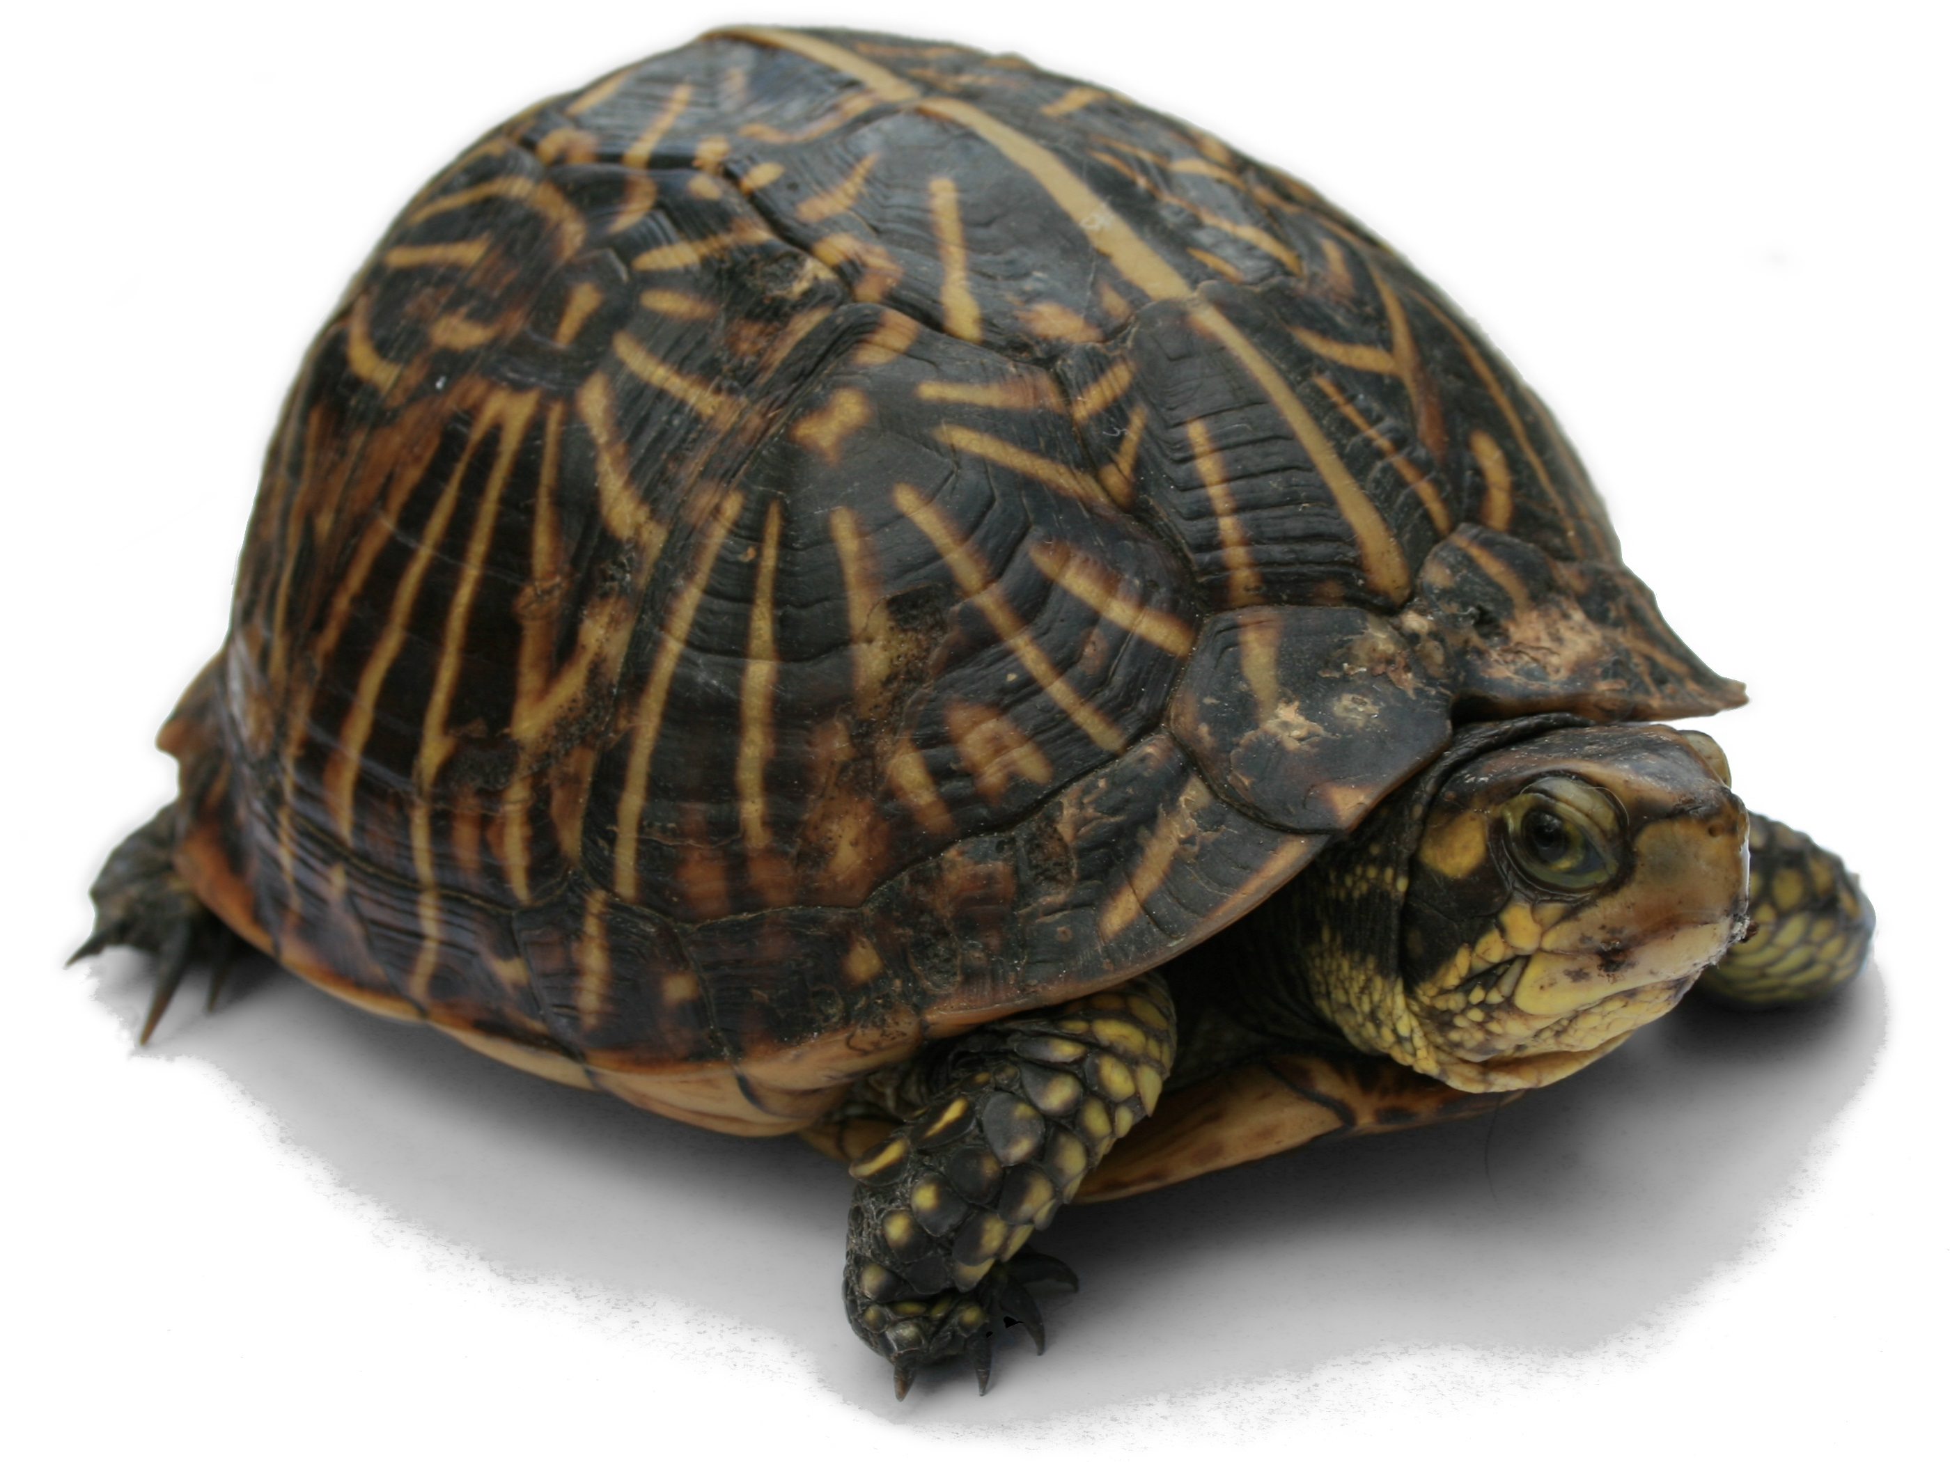
For many, the cost of a laptop plays a decisive role, while important parameters are overlooked. As a result — regrets after the first days of operation. At the same time, even a famous brand and a high price do not guarantee that you will get what really suits you. Often, even with a huge choice, users are forced to compromise, so long as a couple or three important parameters match.
Therefore, first of all, it is worth deciding for what purpose you are purchasing a laptop. This will depend on the size and resolution of the screen, the processor, video card and the amount of RAM.
The most common problem statement is a machine for working with documents, multimedia and surfing the Internet. For these purposes, a CPU with average performance and an integrated video card is suitable. When choosing a model, many users are guided by the low price of the device, losing sight of the fact that the computer has an outdated processor with low efficiency. At first, the weak heart of the computer will demonstrate acceptable speed in office applications and when surfing the net. However, as soon as Windows runs an update in the background, a virus scan, or simply copying files to an external drive, the machine will turn into a prehistoric turtle.
• The Intel Core i5 and i7 CPU models will allow you to have some margin in computing power - they are used in powerful workstations and gaming mobile PCs. Also, on sale you can find laptops with Ryzen 5 processors from AMD, which have good integrated graphics on board, which is approximately on par with the GT 1030.

Slide 39


• Recently, manufacturers have been actively exploiting the trend of screens with 4K resolution (3840 × 2160). In my opinion, it is a mistake to succumb to marketing traps and pay attention to such offers in portable devices. The fact is that the human eye already has difficulty distinguishing pixels on a 23-inch monitor with Full HD resolution from a distance of 40 cm. At 17 or 15 inches, you definitely won’t feel an increase in image quality. At the same time, a 4K monitor will show too small elements of the Windows interface and programs, which will only cause discomfort. It should be borne in mind that a more detailed display of graphics in 4K takes resources from the video card and CPU. Therefore, the best screen resolution for a laptop is 1920x1080. If you want more, connect your computer to a large UHD monitor and enjoy an ultra-detailed picture on it.

Slide 40

• Many manufacturers, in an effort to win in the competition, save on additional slots in laptops by installing only one storage device. Choosing such a model, for example, with a fast SSD, you risk being left without a system and without personal data.
The option with one HDD is also not very preferable, because. This type of media today demonstrates very low data exchange rates. Your system will be slow to boot, and applications will be annoying with the slowness of launching and processing data. Therefore, when choosing a device, give preference to the SSD + HDD dual disk system.
• RAM Type is more important than capacity for price, DDR5 is the most expensive
• For office work and surfing the Web, it is desirable to have at least 4 GB of RAM. For graphics , 8 GB is enough. Complex tasks and gaming may require 16 or even 32 GB of RAM. In the latter case, it is important to have both a very productive and expensive CPU. Before buying, ask how the memory is installed - one module or two equal parts, i.e. in dual-channel mode, which somewhat speeds up data processing.

Slide 41


